Slide 1
A study on in-depth analysis on banks products and services and exploring the attributes affecting the banks overall performance.

Slide 2
01.
Introduction
02.
Research Problem
03.
Objectives
Content
04.
Research Questions
05.
Methodology
06.
Results
07.
Conclusion

Slide 3
Introduction
In order to comprehend how various services affect a bank's overall performance, we dive into the complex subject of banking in this research. As the financial landscape changes, we want to find out what the main factors are that affect banks. In order to support an effective and successful banking industry, our investigation aims to provide insights that help these institutions in growing and adapting to continuous change.

Slide 4
Research Problem
At present, customers are stopping and quitting their relationships with bank, and they use alternative ways for their financial needs. For an example they invest their money in trading and real estate, and they invest in cryptocurrency. So, this activity of consumers hast the biggest negative impact in bank organizations. And bank resources are not planning properly to take effective output from those resources, finally most of the banks which don’t have proper insights about their customers facing many financial issues so these banks should consider to identify the risk profile of the customers. The goal of this research study is to explore and analyze in-depth analysis on banks products and services and exploring the attributes affecting the banks overall performance.

Slide 5
Objectives
01
Explore and analyze the factors that affect decisions of customers to make deposits in bank and build a model to predict customer decision regarding deposit.
02
Explore the factors that affect telemarketing phone call duration that makes to customer and build a model to predict tele marketing call duration
03
Identifying the risk profile of groups of customers who have default credit based on age and bank balance of them.

Slide 6
Research Questions
01. What are the features that affect the decisions of customers to make deposits in bank and which model is suitable to predict it?
02. What are the factors that affect telemarketing phone call duration that makes to customer and which model is very suitable to predict call duration?
03. Which group of customers have risk profile and how we can reduce the risk?

Slide 7

Methodology
Descriptive Statistics
Data Visualization
Regression Models
Classification Models
Clustering Model

Slide 8




Results

Slide 9
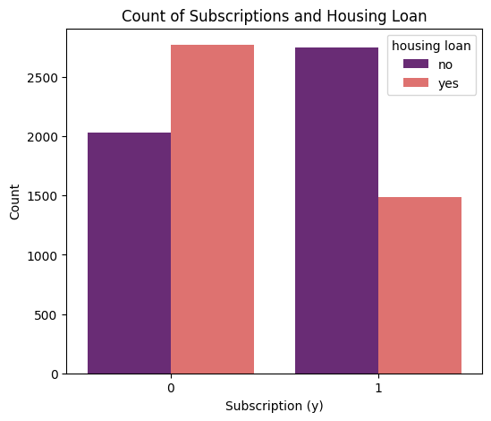
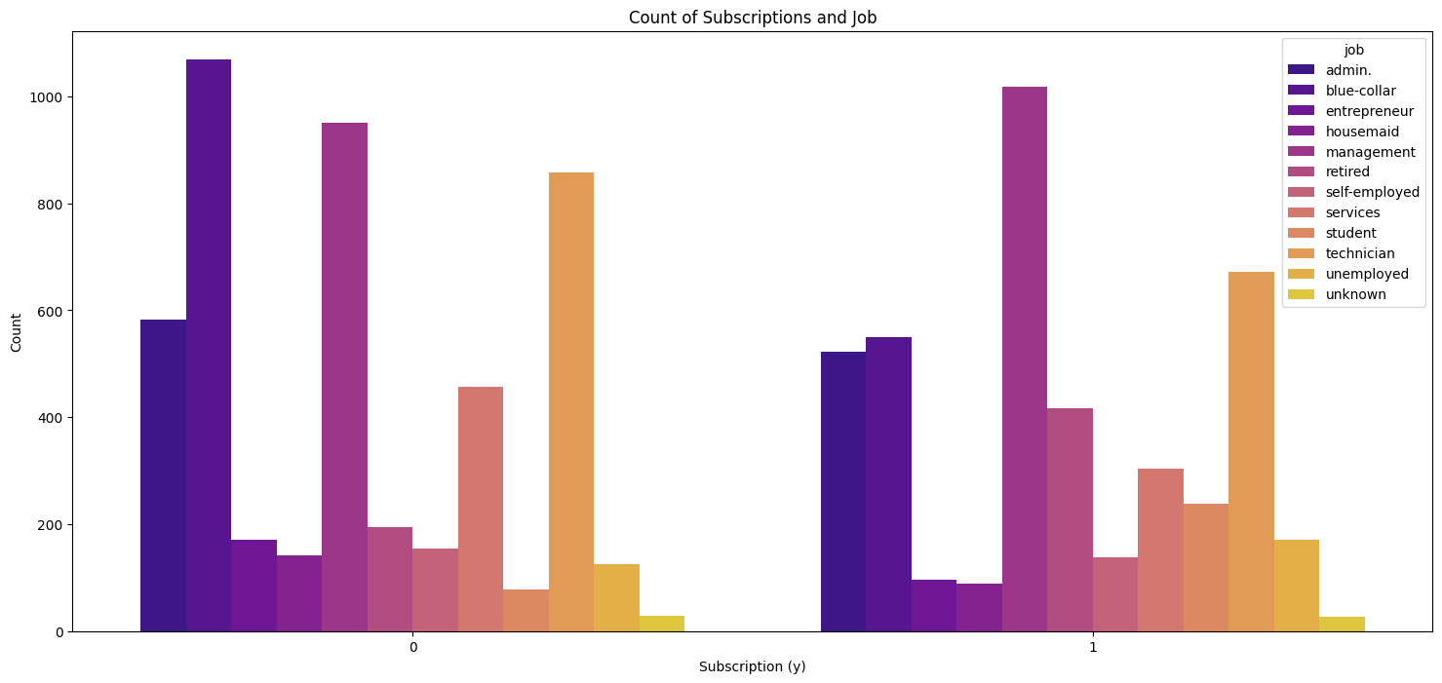
Explore and analyze the factors that effect decisions of customers to make deposits in bank and build a model to predict customer decision regarding deposit.

Slide 10
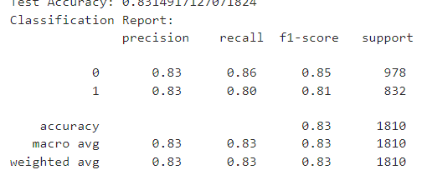
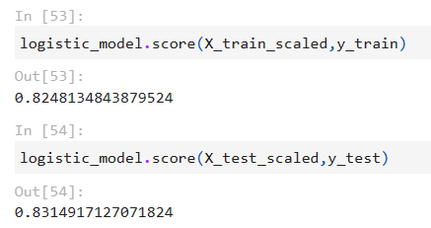
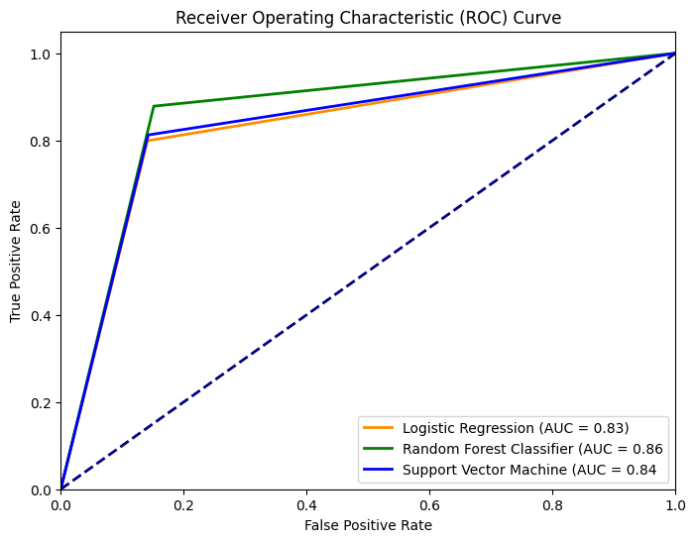
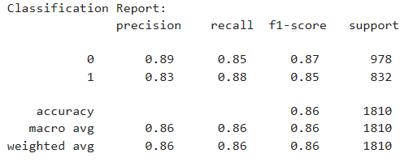
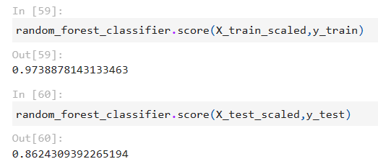
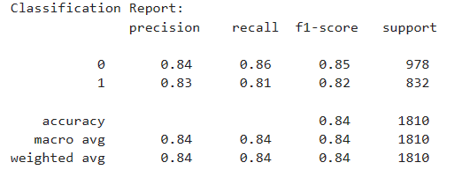
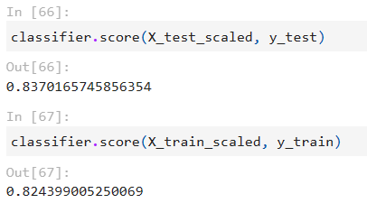
Explore and analyze the factors that effect decisions of customers to make deposits in bank and build a model to predict customer decision regarding deposit.

Slide 11
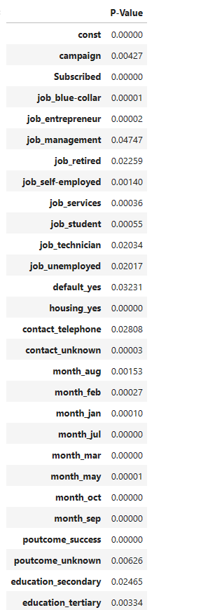
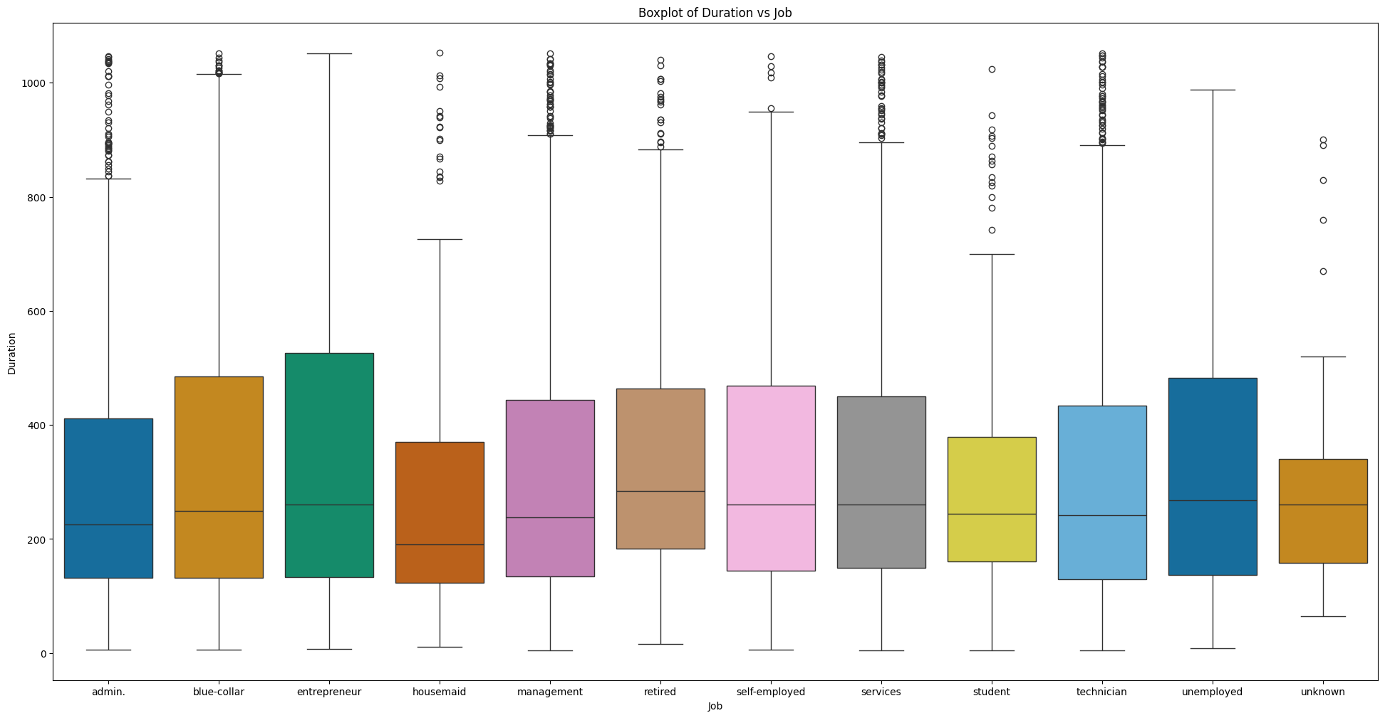
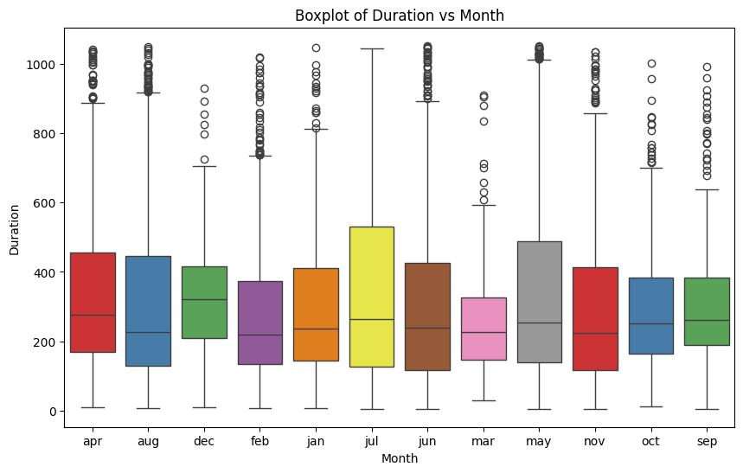
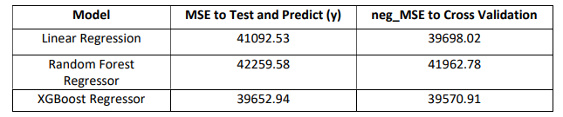
Explore the factors that effect telemarketing phone call duration that makes to customer.

Slide 12
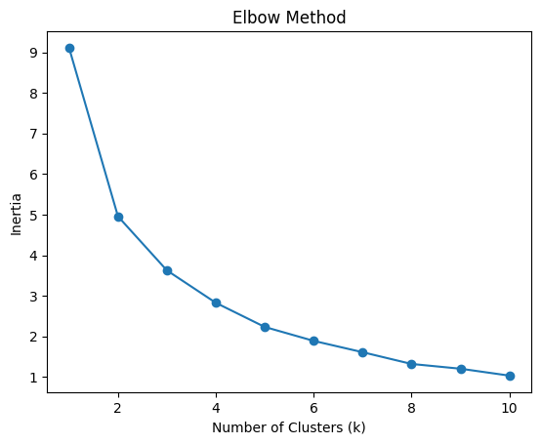
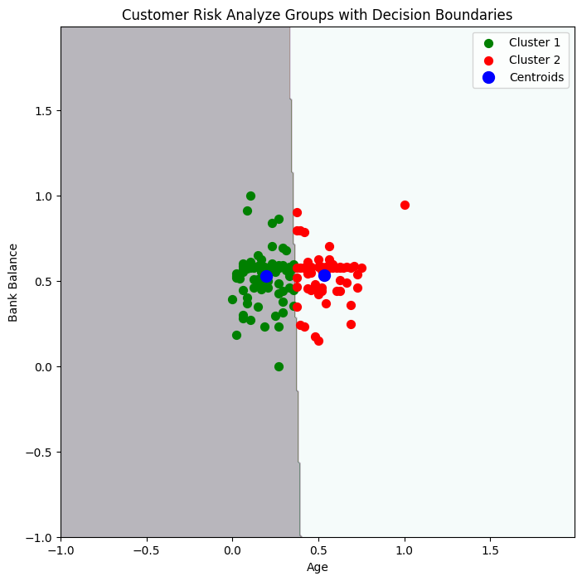
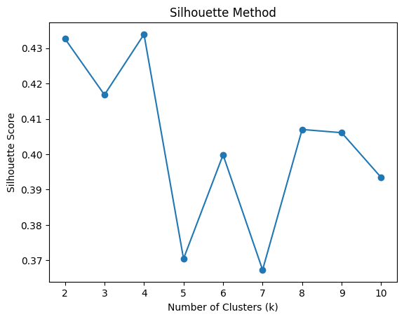
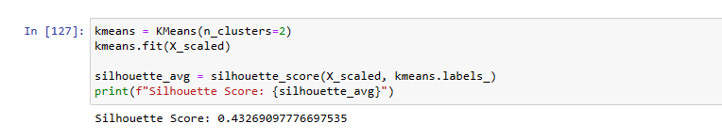
Identifying the risk profile of groups of customers who have default credit based on age and bank balance of them.

Slide 13
Conclusion
W
STRENGTHS
This research goals are to analyze the factors that contribute to term deposit subscription and the telemarketing call duration, build a predictive model to predict telemarketing call duration and whether customer accept or reject the term subscription and to analyze the risk profile customers of the bank by analyzing their bank balance and age.
This dataset is secondary data set so, according to that there are some areas should investigate
more,
There is a category call ‘unknown’ so it’s a big mistake we can’t get proper insights on
categorical data which include class unknown.
This dataset did not mention the way data was collected and which specific area and bank is this.
S
WEAKNESS
SWOT
T
OPPORTUNITIES
O
THREATS

Slide 14
THANK YOU

